Slide 1


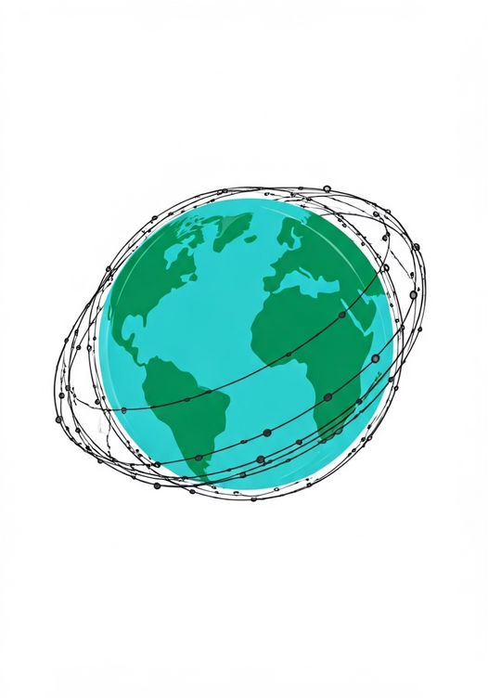
SUSTAINABLE LIVING ADVISOR
AN INNOVATIVE AI-DRIVEN PERSONALIZED GUIDANCE SYSTEM FOR FOSTERING ECO-FRIENDLY LIFESTYLES.
Sustainable living aims to minimize an individual's ecological footprint through responsible choices in energy, diet, consumption, and waste management.
The Sustainable Living Advisor is an AI-powered tool that helps you make eco-friendly choices based on real-time environmental data. It uses advanced technologies to analyze information from sensors and satellites, providing personalized recommendations tailored to your habits and local conditions. Whether it's tips on reducing energy use or recycling strategies, this system empowers you to adopt sustainable practices in a simple way. By understanding your lifestyle and the environment around you, the Advisor makes it easy for you to take action for a greener future and contribute to the health of our planet.

Slide 2






OBJECTIVE: AI-DRIVEN ECO-GUIDANCE
Analyze & Personalize
Actionable Recommendations
Apply machine learning to analyze individual lifestyle habits and local environmental data, including CO2 emissions, air quality, and usage patterns for energy and water.
Provide specific, actionable tips to reduce carbon footprints, optimize energy use, and promote eco-friendly behaviors like plant-based diets, efficient waste management, and energy-saving home improvements.
Utilize ML models (CNNs, SVMs, neural networks) to process user behavior and real-time environmental data (CO2 levels, air quality, resource usage).
Real-time Adaptation
Monitor & Engage
Utilize real-time satellite and sensor data to deliver adaptive, region-specific guidance, ensuring relevance and immediate impact based on current environmental conditions.
Monitor environmental impact with continuous feedback, promoting long-term sustainable habits and connecting users to local green resources to foster community engagement.
Give users immediate feedback to help them develop lasting eco-friendly habits and continually reduce their environmental impact.

Slide 3

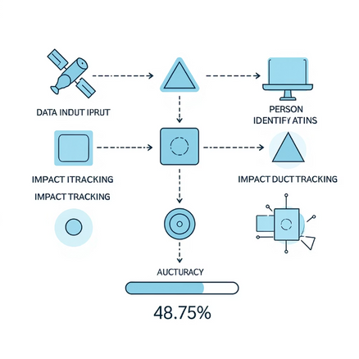
ABSTRACT: CORE & MECHANISMS IMPACT
Core Technologies: Utilizes cutting-edge methodologies, including:
  Convolutional Neural Networks (CNNs): For image processing and feature extraction.
  Transfer Learning: Leveraging pre-trained models to enhance performance with limited data
  Ensemble Methods: Combining predictions from various models to improve accuracy and robustness.
Data Analysis (Input Data): The model analyzes multimodal environmental data, such as:
  Satellite Imagery: For visual detection of ecological changes.
  Sensor Readings: For real-time monitoring of environmental parameters.
  User Inputs: Personalized data to enhance recommendation relevance.
Data Preparation
  Dataset: Includes 5,920 samples.
  Processing:
a) Rescaling: Images resized to 128x128 pixels.
b) Normalization: Standardizes data values.
c) Augmentation: Increases data variety to improve training.
Neural Network Architecture
Model Composition:
  Dense Layers: For feature learning
  Long Short-Term Memory (LSTM) Layers: To capture sequential dependencies in time series data
  Dropout Layers: Implemented to prevent overfitting.
Activation Functions:
  ReLU (Rectified Linear Unit): Employed for hidden layers to introduce non-linearity
  Softmax: Used in the output layer for multi-class classification, providing probabilities for each ecological impact category.
Performance Metrics
•The configuration achieves a commendable 88.75% accuracy on test datasets, indicating high reliability in classifying ecological impacts like deforestation, pollution, urban sprawl, and biodiversity loss.
User Engagement Features
  Real-time Recommendations: Provides personalized sustainability advice based on user behavior and environmental data
  Impact Tracking: Monitors and reports the user's ecological footprint, fostering a more conscious lifestyle.
  Behavior Change Encouragement: Actively motivates users with actionable insights and community-driven challenges.
Scalability: The designed system is versatile across:
  Residential Areas: Suggesting home improvements for energy efficiency.
  Commercial Entities: Helping businesses reduce waste and optimize resources.
  Industrial Sectors: Offering insights into compliance with environmental regulations.
Key Highlights
  Data Processing: Rescaling to 128x128 pixels, normalization, and augmentation for enhanced robustness and model performance.
  Performance: Achieves 88.75% accuracy on test sets, evaluated rigorously using metrics like precision, recall, and F1-score.
  Broader Impact: Promotes global sustainability by bridging environmental awareness with practical action, empowering individuals and communities.

